Slide 1
Assignement 02 (group 36)
Designing Interactive Systems I
Filip Gruczka, Ulfet Cetin, Bartosz Lipiński

Slide 2
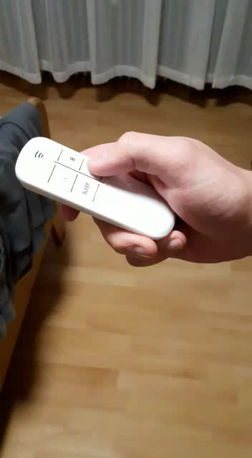
DESCRIPTION OF THE REMOTE CONtROL

Slide 3
We asked Ania and Kacper to use the remote control. We just told them that is the device to switching on and off the light in the room. They had to figure out how to use it

Slide 4
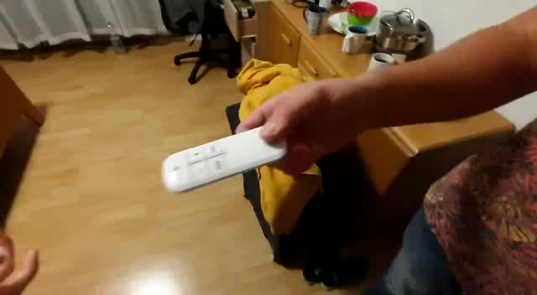
User 1 Experience

Slide 5
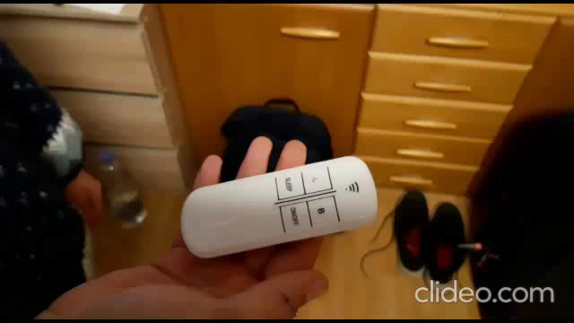
User 2 experience

Slide 6


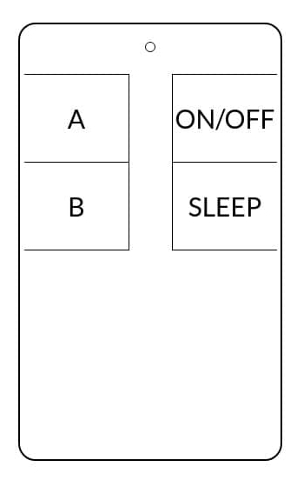
Redesign
How the redesign conveys a correct conceptual model to the user: We decided to remove wrong WIFI looking sign (misleading signifier). We just kept in the top the light signifier. Because it is great design idea, we have feedback after clicking each button. The user will immediately see his/her action on remote control. Furthermore, regarding to Gestalt Laws (Law of proximity) – we decided to group buttons into two groups. The first one – pre built functionalities (ON/OFF and SLEEP buttons). The second group – buttons that can be programmed by the user. Regarding to this law we made more space between groups. With automatically allows user to distinguish between groups. We made border for each button, with rapidly indicate clickable area for the user. We removed black middle line between two groups of buttons. First of all it was grouping buttons incorrectly. It was grouping button A and button SLEEP together and button B and ON/OFF together too.

